Slide 1
Project 1.2
Olivia Justynski, Yuyang Liu, Jiawei Wang

Slide 2
Compare the variants in Carl’s genome with those found in the GTEx database. Use the results to predict gene expression in various tissues and better estimate the impact of noncoding variants in Carl’s genome.

Slide 3
Writing
Describe eQTLs and the GTEx database. How was the data present in GTEx generated and what scientific questions does it help answer?

Slide 4
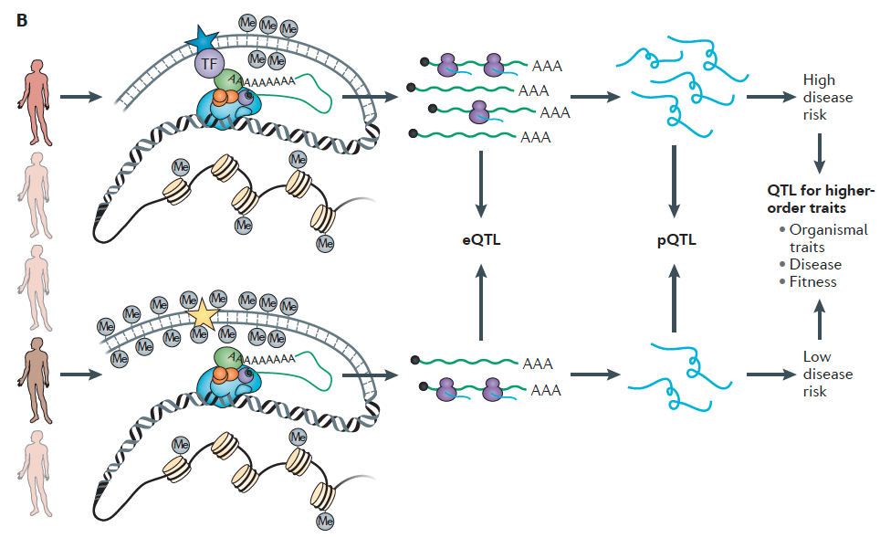

Slide 5
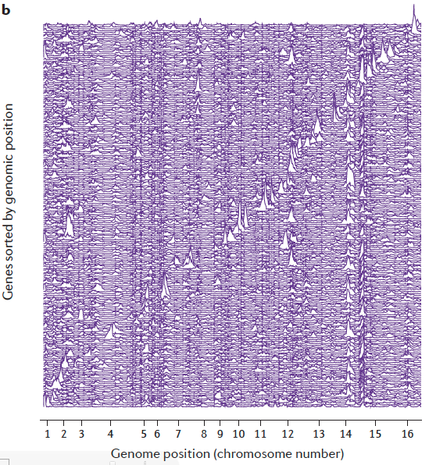

Slide 6
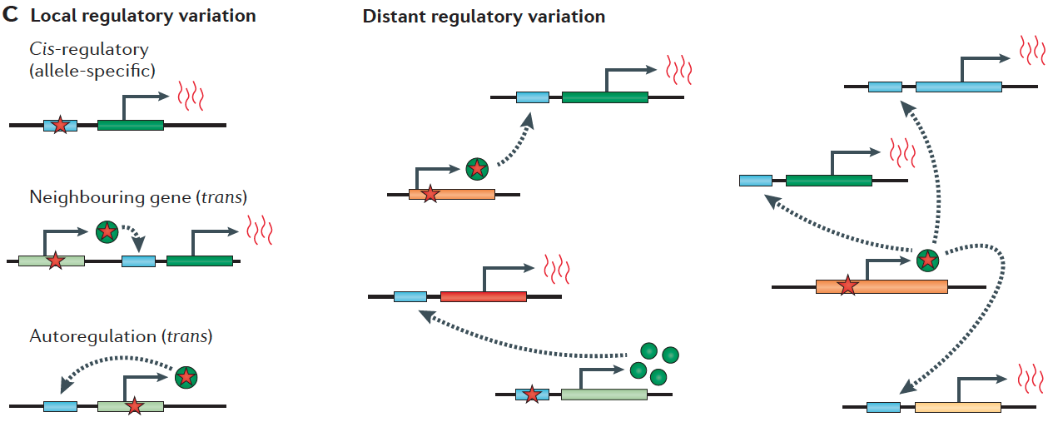

Slide 7
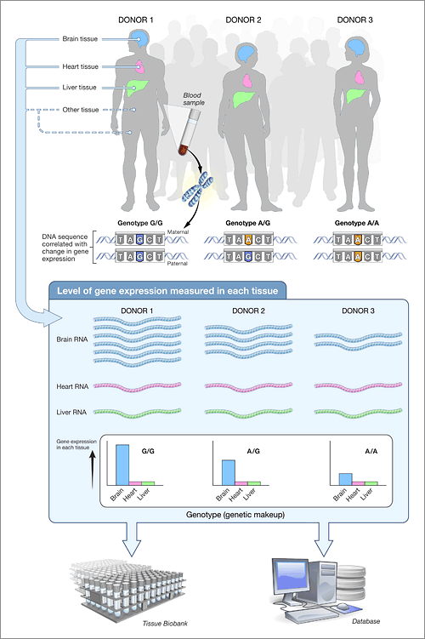

Slide 8
Coding
Propose a tool to identify eQTLs in a subset of Carl’s variants using the GTEx database. What expression changes would you predict in Carl? Make sure to cover tissues that can be easily assayed.

Slide 9
Brief introduction
Read in Zimmerome SNPs
Find the overlapping SNP-gene-tissue pairs between Zimmerome SNPs and GTEx eQTL database
Print out the overlapping SNP-gene-tissue pairs, intersection and statistics
Final1-2.2.py, final1-2.2.3.py, final1-2.x.py

Slide 10
Result example

Slide 11
Summary statistics
Tissue | #Z eQTLs | #total eQTLs | %GTEx | %Coverage | %Common
Adipose Subcutaneous | 137526 | 1311216 | 10.5 | 3.93 | 14.8
Brain Cortex | 125373 | 154580 | 81.1 | 3.59 | 13.5
Liver | 74823 | 189024 | 39.6 | 2.14 | 8.06
Pancreas | 231229 | 526676 | 43.9 | 6.61 | 24.9
Whole Blood | 448413 | 1060536 | 42.2 | 12.8 | 48.3
Notes:
Most of the SNPs are not eQTLs, to current understanding
Tissue specificity
Brain tissues shares most common eQTLs: conserved and important
Whole blood shares the highest percentage of common eQTLs: blood connects the whole body
Zimmerome or not: blood related eQTLs may have the biggest influence on biology, since highest coverage

Slide 12
Pipeline
Process the variants in Carl’s genome to identify any eQTLs. Look at multiple tissues (make sure to include tissues that might be able to be tested in a noninvasive manner e.g. blood).

Slide 13
eQTLs identified in different tissues

Slide 14
eQTL Chromosome Distribution

Slide 15
eQTL Chromosome Distribution

Slide 16
eQTL Chromosome Distribution

Slide 17
eQTL Chromosome Distribution

Slide 18
eQTL Chromosome Distribution

Slide 19
eQTL Chromosome Distribution

Slide 20
A hotspot of eQTL on Chromosome 6

Slide 21
Distribution of cumulative effector size

Slide 22
Sample GO analysis--pancreas

Slide 23
Regulome DB analysis
First 3x10⁶ nucleotide on chromosome 1 as input dataset
Score higher than 1f are classified as eQTL

Slide 24
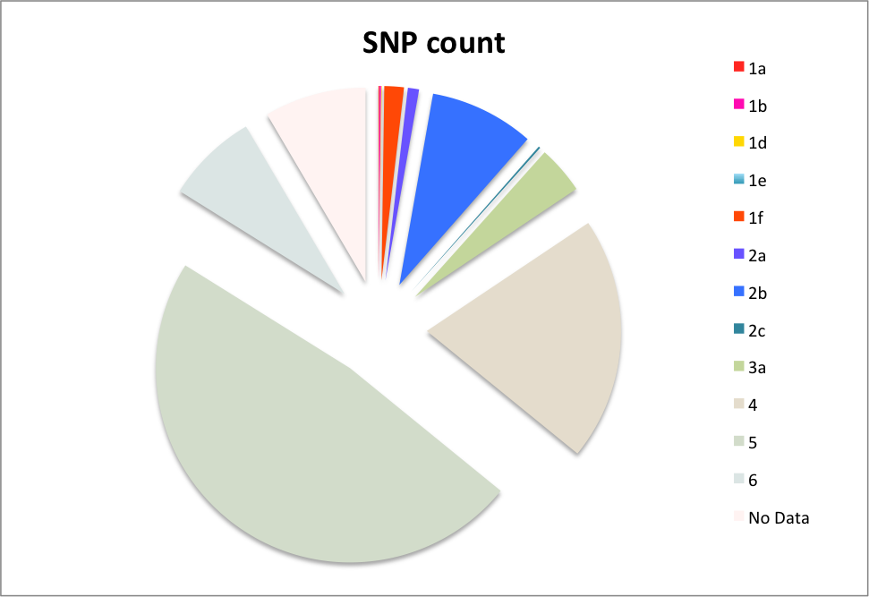
RegulomeDB scores

Slide 26
Example eQTL: rs1886730
Score 1b
Affects expression of TNFRSF14 in lymphoblastoid
http://www.regulomedb.org/snp/chr1/2488607

Slide 27
http://www.regulomedb.org/snp/chr1/2488607

Slide 28
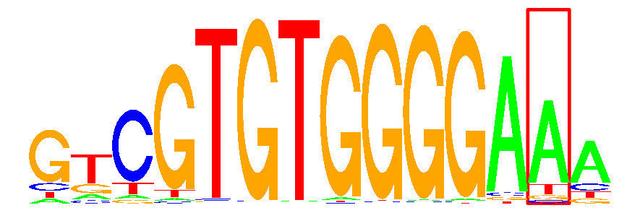
Located within the binding site of FOXO6
Evidence from multiple ChIP-Seq experiments
Near active RSS
http://www.regulomedb.org/snp/chr1/2488607

Slide 29
Correlation between eQTLs predicted by two methods

